Slide 1
Mix Your Mode
Sandy McGroarty
Green-Schools Travel Officer
Mix Your Mode Presentation
Green-Schools Travel
Travel Initiative March 2014

Slide 2
An Taisce
The National Trust for Ireland
An Taisce's Environmental Education Unit is responsible for developing and operating some of Ireland's most popular and successful environmental programmes and campaigns.
An Taisce EEU are part of the international Foundation for Environmental Education (FEE)

Slide 3

An Taisce’s Environmental Education Unit

Slide 4
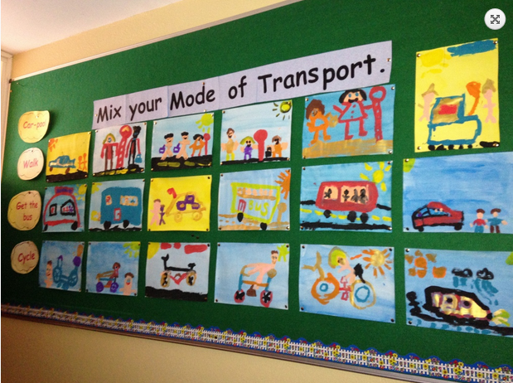
What is it?
One week from 24th -30th March
Encourages people to mix their mode of transport with an emphasis on more sustainable ways of getting around
Bus, train, cycling, walking, carpooling, park’n’stride, ecars, ebikes, Gocar, public bikes.
The aim being that through positive experiences in adapting new ways of getting around people will change their everyday behaviour.

Slide 5
Who is the Transport and Mobility Forum?
Cork City and County Council
Bus Eireann
Irish Rail
Green Schools and SMILE Programmes
University College Cork
Cork Institute of Technology
HSE Health Promotion Unit & Healthy Cities
Cork Community Bikes
South East Cork Area Development (SECAD)
South West Regional Authority (SWRA)
RED FM

Slide 6
Who are we targeting?
Schools and colleges: A number of schools engaged with the Green Schools will participate and both University College Cork and Cork Institute of Technology will promote mixing the mode by which students get to college. By engaging with the schools you also reach staff and parents.
Workplace: A number of key workplaces, some already engaged with the NTA Workplace Travel initiative, will engage in promoting changed behaviour by mixing how you get to work. We are looking for key business networks to support the initiative.
Shopping & leisure activities: The initiative also focuses on people going to the city or local commuter towns to shop and to their leisure pursuits such as a football training, a yoga class or meeting friends.

Slide 7
What’s Happening?
Monday 24th- FOCUS ON SCHOOLS
Bishopstown, Carrigaline.
Tues 25th March- FOCUS ON COLLEGES (UCC)
Dr Bike, Campus Cycle
Wed 26th March- FOCUS ON COBH
Schools, Irish Rail, Harbour tours.
Thurs 27th March- FOCUS ON WORKPLACES
Mahon Point
Friday 28th March- FOCUS ON SHOPPERS
“In town with Bike or Bus”

Slide 8
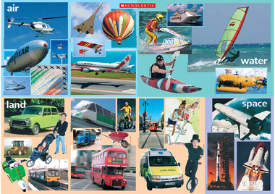
How many modes of Transport can you list?

Slide 9
Car
Costs
Air Pollution
CO2 emissions
Traffic congestion
Reduced health and fitness
Safety on the roads
Parking space

Slide 10
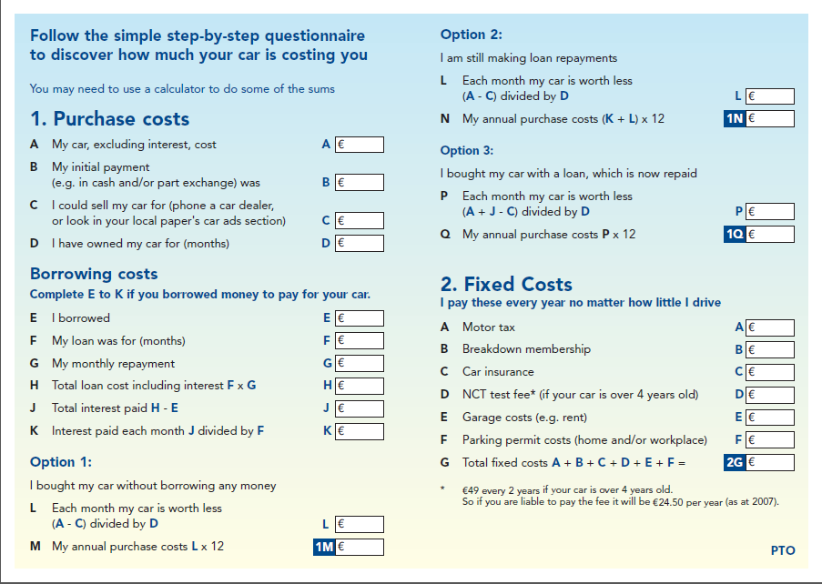

Slide 11
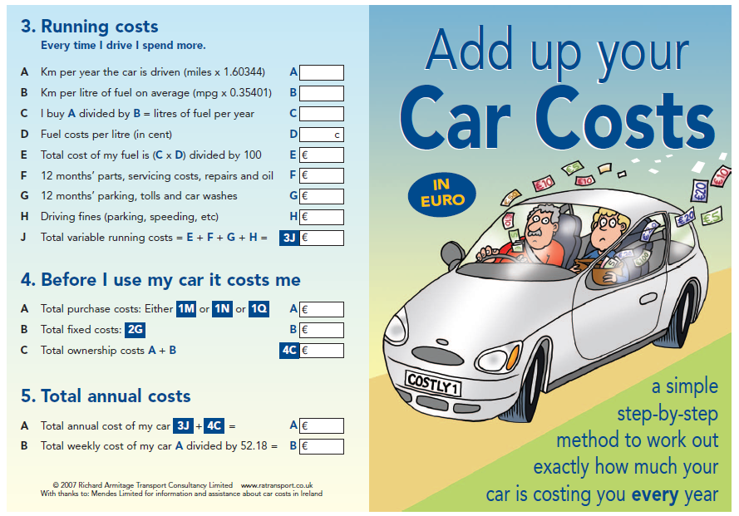
Car

Slide 12
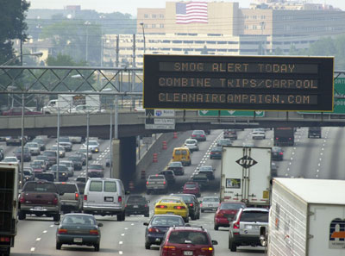
Car-based + Car-dependant Urban sprawl
CAUSES
Affluence: Over the last 20 years car ownership in Ireland has grown hugely - a 54% increase between 2006 + 1990
Poor planning from 1960s
Dispersed populations – the work commute.
Road freight experienced the largest growth in transport energy use since 1990 increasing by 255%.
EFFECTS
Traffic congestion
Localised Air and Noise Pollution
Urban centre decline
Damaged social cohesion + sustainable communities

Slide 13
Health
“One boy in five and one girl in four, aged between 5-12 years are overweight or obese in Ireland” National Children’s food survey, 2005.
Type II Diabetes on the increase
Air pollution increases toxins in the air (urban cancer rates)
Effects of eating imported food (usually sprayed and low in nutrients)

Slide 14
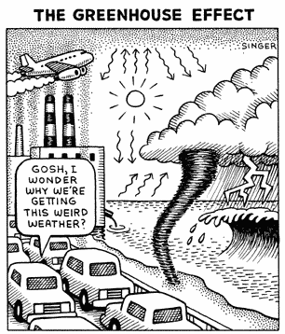
CLIMATE CHANGE
The transport sector recorded a 7.1% growth in emissions in 2006 compared to 2005. Transport now accounts for 35% of energy related emissions. SEAI, 2006
About 40% of carbon emissions in the UK are the result of decisions taken directly by individuals. The biggest sources of emissions for most people are likely to be:
* energy use in the home (the main use is heating)
* driving a car
* air travel
"It has been demonstrated beyond reasonable doubt that the climate is changing due to man-made greenhouse gases. We are already committed to future substantial change over the next 30 years and change is likely to accelerate over the rest of the 21st century."
The Met Office, Hadley Centre, UK.

Slide 15
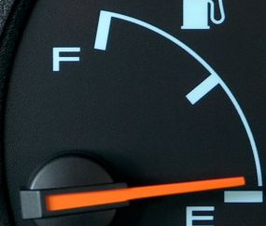
PEAK
OIL
CAUSES
Cheap Fossil Fuel energy
Finite resource
Oil production has reached its peak
EFFECTS
Security of supply
Food security

Slide 16
Causes
Globalisation- Global production and distribution networks, air travel, global economies.
Poor public transport
Environmental effects not included in costs
Pedestrian and cyclist safety
Lack of awareness or key Values

Slide 17
HOW DO WE GREEN OUR TRANSPORT ?

Slide 18
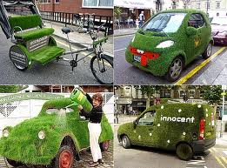

Slide 19

What are sustainable modes of transport?

Slide 20
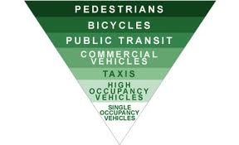
Think Global, Act Local

Slide 21
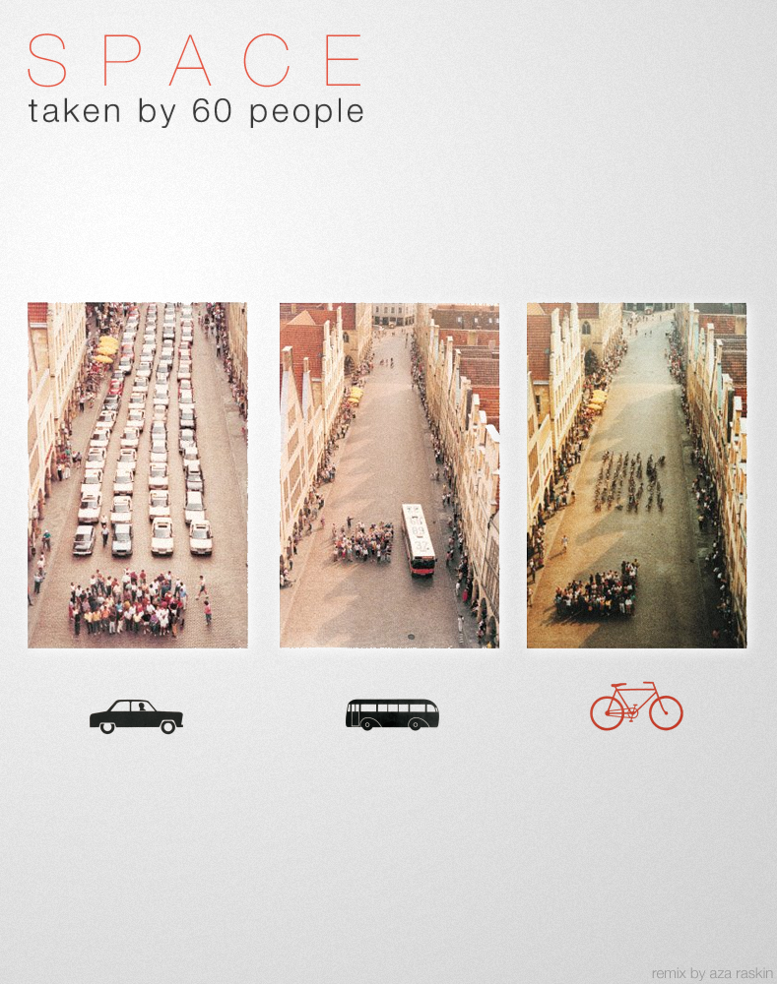
Walking

Slide 22
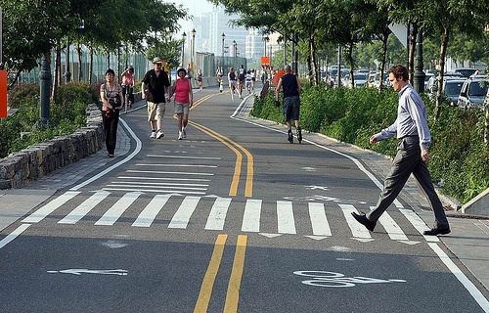
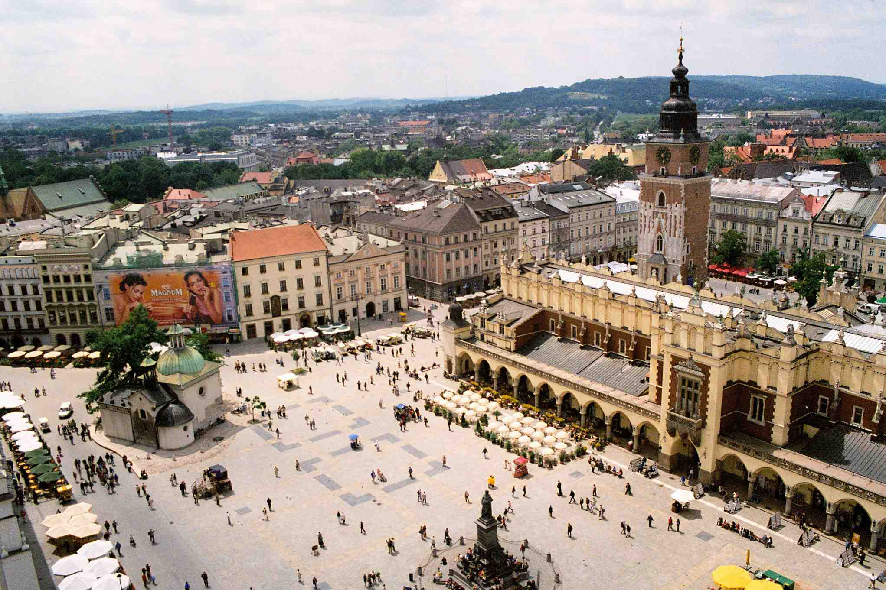
Walking
Notes:
- Walking at a brisk pace for up to 30 minutes a day can help you reduce the risk of many health conditions such as diabetes, heart disease, stroke and some cancers
- Walking is free and convenient to do and can be done anywhere. Walking as part of your activities of daily living is the healthy easy way to get around
- Walk with a friend – not only is it safer, it’s a great motivation to keep going
- More energy – we spend so much of our day sedentary – sitting down! Any opportunity you have to walk no matter how small we will feel better getting fresh air, helping our bones and joints and reenergising ourselves
- Every time you walk instead of driving its saving you money, save the money up and treat yourself to what you would have spent on fuel
- Eco-friendly (less pollution/CO2 emissions)

Slide 23

Opportunity
60% of all car journeys are under 5 miles in length
Notes:
Get Fit- Cycling some or all of the way to work, college, or school is a great way to stay fit and add adds to your 30 minutes a day of physical activity that is recommended for health
Save money -Spend money on yourself instead of your car. With rising fuel costs and parking rates it makes sense to think of travelling actively
Healthier Environment - Cycling leads to less cars on the road meaning safer surroundings, cleaner air and less noise for you and your family, less CO2 emissions.
Stress buster- Being active is a proven way to reduce stress and anxiety. No need to stress about traffic jams and getting there on time!
Family Time- If you do some journeys with your child that helps them reach some of the 60 minutes a day physical activity that is recommended for children. Children who have active parents are more likely to be active themselves and its good for them too.

Slide 24
Get On Your Bike
“The bicycle is the most efficient and environmentally benign form of transport ever invented” Chris Peck, Sustainable Development Commission, UK.
Lets make cycling the normal choice for journeys up to 5 miles
HOW???
Improvements in infrastructure and street design
30 kph speed limits in most urban neighbourhoods
Better enforcement of traffic law i.e. protecting vulnerable road users from injury or intimidation
Pro-cycling initiatives
Cycle training and maintenance workshops
Bike racks + parks

Slide 25
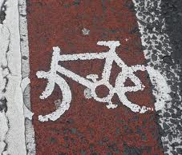
CYCLING
MAKES
SENSE
“Each additional cyclist boosts the economy by between £300-£600 per year in environmental, health and social benefits” SDC, UK.

Slide 26
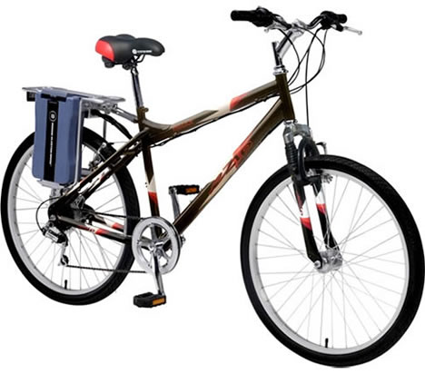
Electric Bike

Slide 27
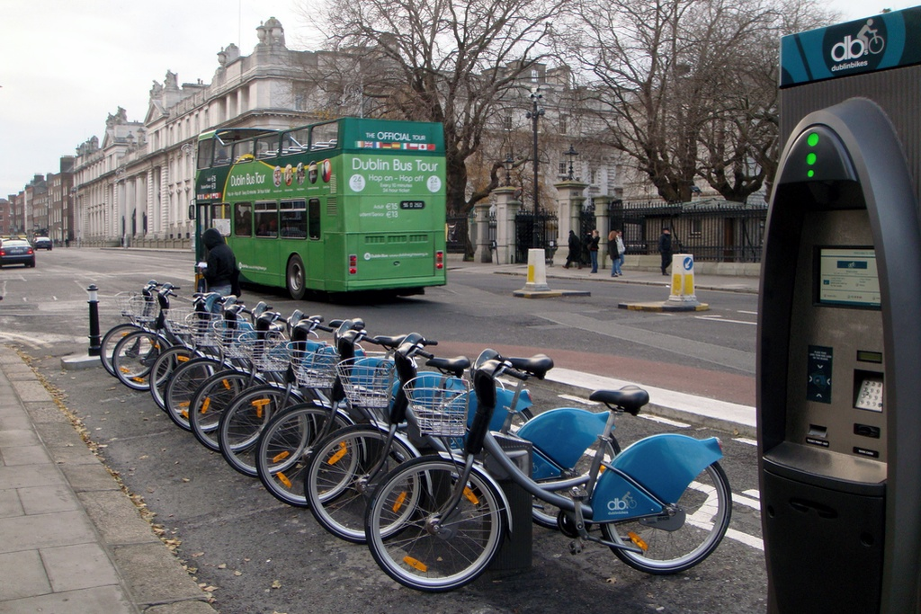
Dublin Bikes: Public Bike Scheme
Notes:
Dublinbikes, the Irish capital's bike hire scheme, will turn two years old this September. With over 58,000 subscribers and 2.2m rentals to date, it has been reported as one of the most successful bike rental schemes in the world. In Dublin, each bike made an average of more than 2,200 journeys in its first year. Comparatively, London's scheme which was a year old at the start of July recorded an average of 1,000 journeys per bike over the year. So what is dublinbikes' secret to success?
The scheme is a joint partnership between Dublin city council and French company JC Decaux. Jason Frehill of Dublin city council project manages the scheme and says its success was due to three main factors: "The fact that the public in Dublin embraced the scheme and are now its guardians, the time taken to find the best location of each station, and the quality of the service delivered by JC Decaux." He explained that the high uptake of dublinbikes was further facilitated by the low annual fee which is a €10 nominal charge.
Dublin city council aims to have a free public transport system for citizens of Dublin and currently 97% of the scheme's usage is under the 30-minute threshold, making it free for users. Any journeys longer than this are charged for.

Slide 28
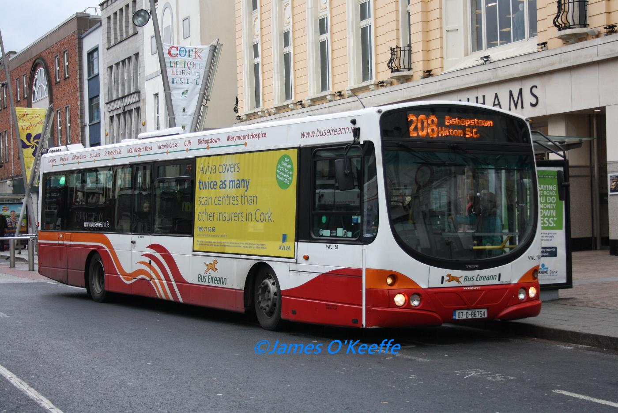

Slide 29
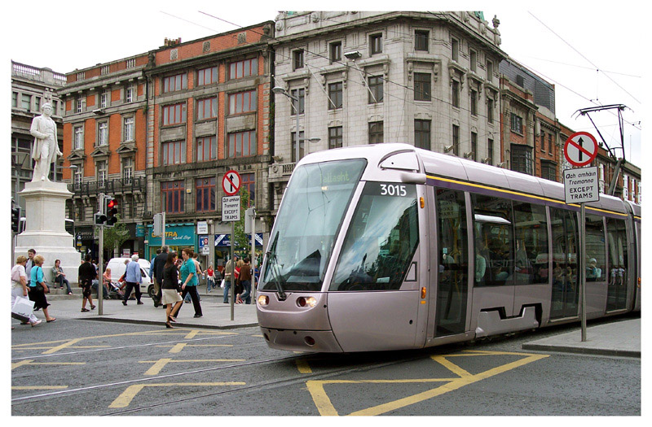

Slide 30
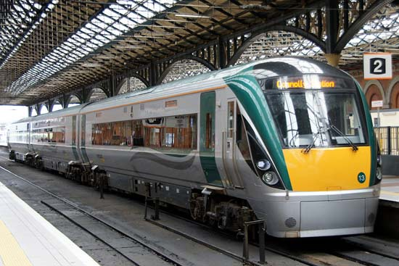

Slide 31
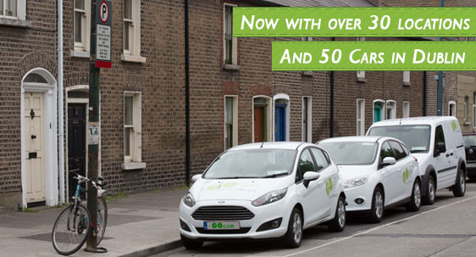
Car rental

Slide 32
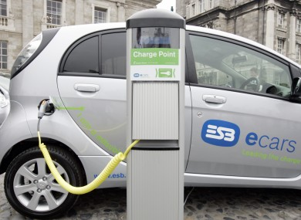

Slide 33
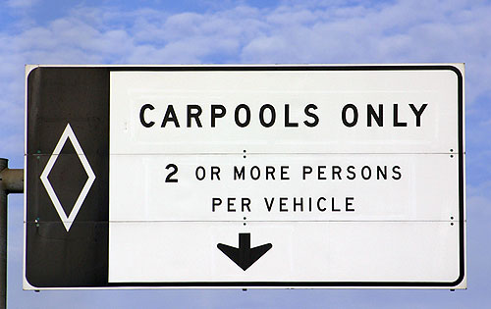

Slide 34
MORE SOLUTIONS...
Walking
Car pooling
Improve public transport
Electric/Hybrid cars
Improve planning – live near your job.
Reduce air transport + travel - Localised economy and food production
Improve Maritime fleet- less water pollution
Biofuels?
Education

Slide 35
Benefits
Reduce emissions
Reduce air pollution
Less dependency on fossil fuels
Improve Health
Less traffic congestion
More road safety for all
Cost effective
Self-sufficiency

Slide 36
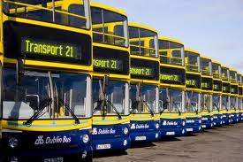
Top-Down Approach
Policy- Smarter Travel Policy, National Cycle Policy Framework
Taxation – Carbon Tax
Incentives- Bike to work scheme
Infrastructure- Transport 21, Electric Vehicles
Awareness Campaigns- National bike week

Slide 37
Bottom-up Approach
Education (ESD) – Green schools travel theme
Community Development – Local Agenda 21
Participatory Decision Making
Awareness Raising
Action-based
Empowerment

Slide 38
EDUCATION
SUSTAINABLE CHANGE

Slide 39
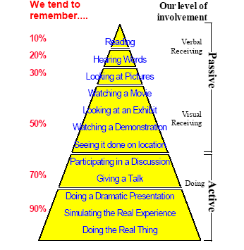
Tell me and I forget.
Teach me and I remember.
Involve me and I learn.
– Benjamin Franklin

Slide 40
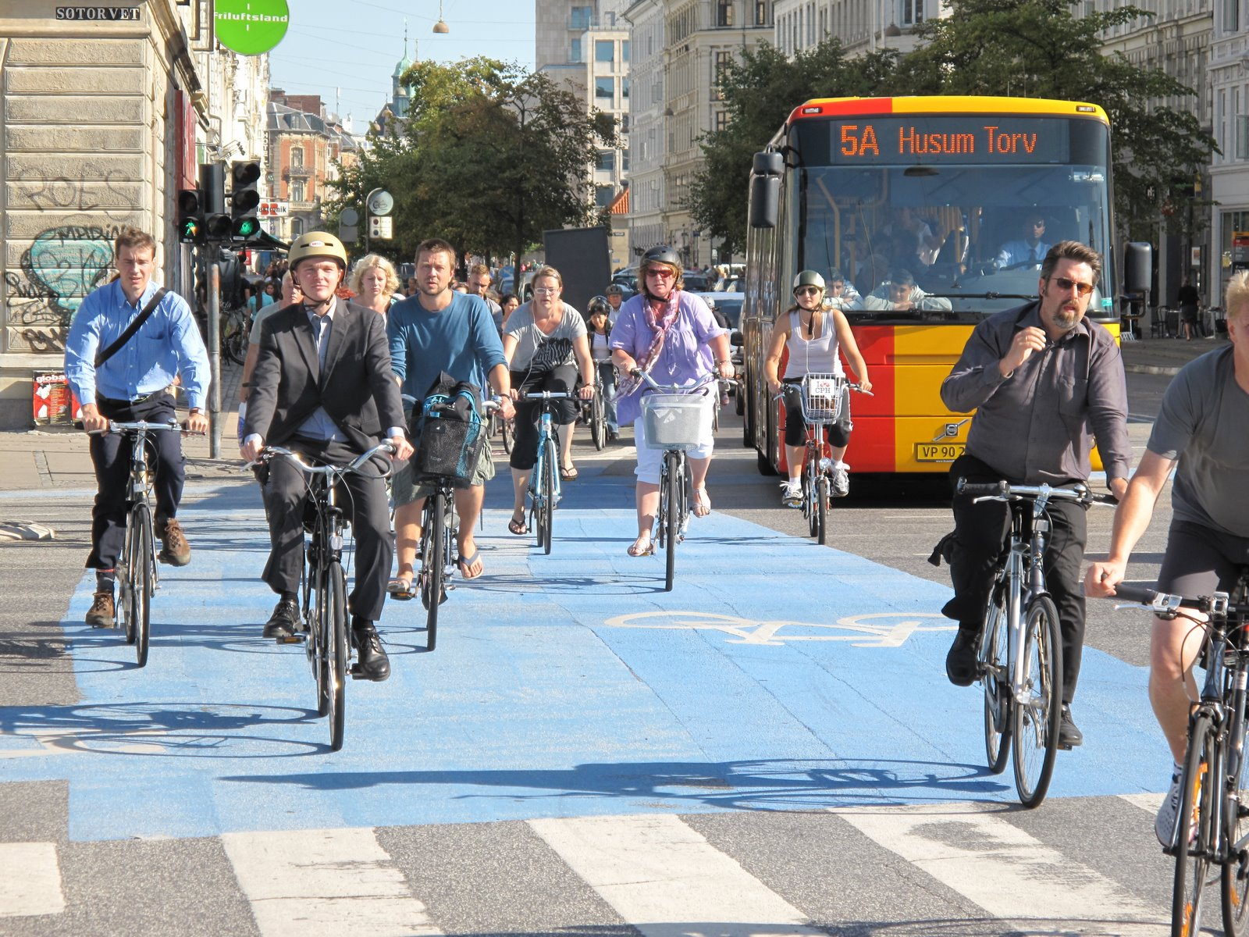
Copenhagen

Slide 41
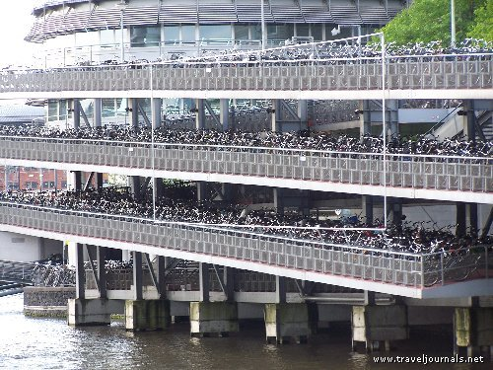
Amsterdam
Notes:
The German city of Hamburg, the 2011 European Green Capital, has announced an ambitious plan to create and link an amazing 27 square miles of new and existing green space all over the city. The result will be a city that puts nature within easier reach of every resident; becomes more resilient to flooding caused by global warming; and provides enough connectivity for walking and bicycling to become car-optional citywide in twenty years.
Angelika Fritsch, a spokeswoman for the city's department of urban planning and the environment,spoke to reporter Elisabeth Braw of the Guardian:
"[The plan] will connect parks, recreational areas, playgrounds, gardens and cemeteries through green paths. Other cities, including London, have green rings, but the green network will be unique in covering an area from the outskirts to the city centre. In 15 to 20 years you'll be able to explore the city exclusively on bike and foot."
In all, the green network will cover an impressive 40 percent of the city’s land area.

Slide 42
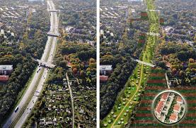
Hamburg
Notes:
The German city of Hamburg, the 2011 European Green Capital, has announced an ambitious plan to create and link an amazing 27 square miles of new and existing green space all over the city. The result will be a city that puts nature within easier reach of every resident; becomes more resilient to flooding caused by global warming; and provides enough connectivity for walking and bicycling to become car-optional citywide in twenty years.
Angelika Fritsch, a spokeswoman for the city's department of urban planning and the environment,spoke to reporter Elisabeth Braw of the Guardian:
"[The plan] will connect parks, recreational areas, playgrounds, gardens and cemeteries through green paths. Other cities, including London, have green rings, but the green network will be unique in covering an area from the outskirts to the city centre. In 15 to 20 years you'll be able to explore the city exclusively on bike and foot."
In all, the green network will cover an impressive 40 percent of the city’s land area.

Slide 43
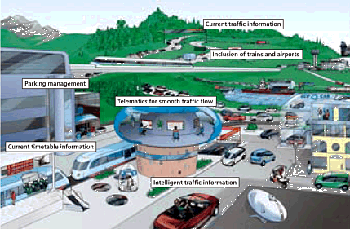

Slide 45

Thank you!
www.greenschoolsireland.org

