Slide 1
Green Schools
Presentation

Slide 2
1. Summary
The Green Schools Committee is a group of students that are committed to keeping and maintaining the school a litter free and an energy efficient establishment. We work towards keeping and obtaining Green Flags.
This year we are working towards getting the Water Flag. We have already been awarded our Litter and Recycling flag as well as our Energy flag.

Slide 3
2. Important People
A Green flag is awarded to a school on the basis that it is a whole school initiative. The efforts of every member of the school community is essential: students, teachers, parents, secretaries, caretakers, management and all other school staff.
The Green Schools Committee take on the responsible role of leading the way to achieving our aims as an environmentally friendly school community.
Ms. White is the co-ordinator of the committee and organises the meetings.
Ms. Lenihan facilitates the computer room meetings and the running of the school website.

Slide 4
3. Achievements
To date, Coláiste Muire has obtained 2 Green Flags. We are working towards our third green flag.
Please visit the site frequently for updates on the work going on in the school and community.

Slide 5
Joining
The Green Schools meet every Monday at 1:20 in Room 13.
Anyone from any year is welcome to join.
There are many benefits to the Green Schools and the work is very rewarding.

Slide 6
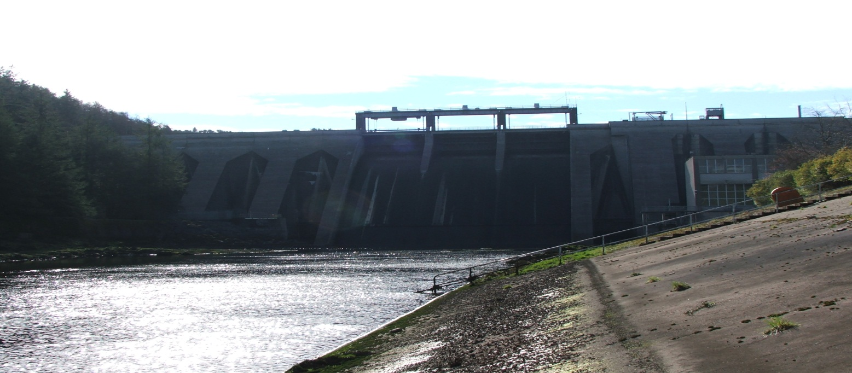
Excursions
We very much enjoy our outings which have included making a presentation at an oral hearing, Fota Wildlife Park, the Water Treatment Plant, The Lifetime Lab and Inniscarra Dam.

Slide 7
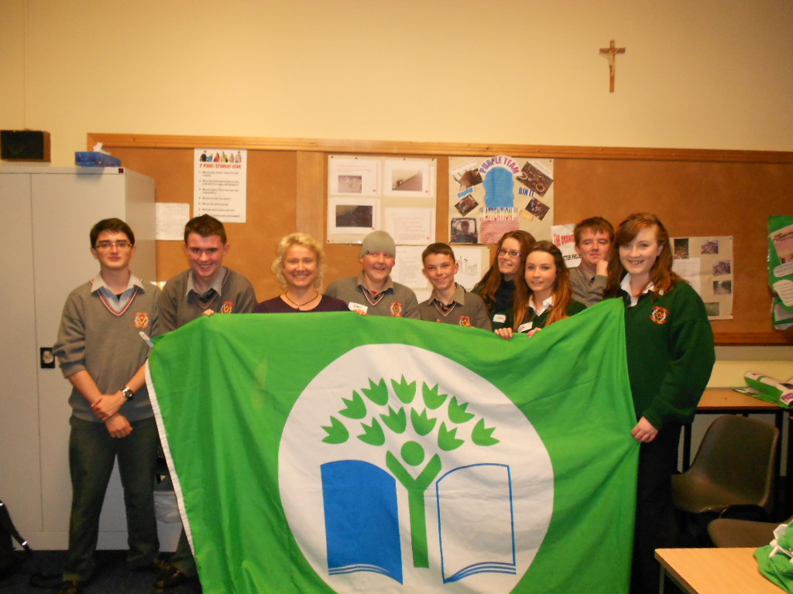
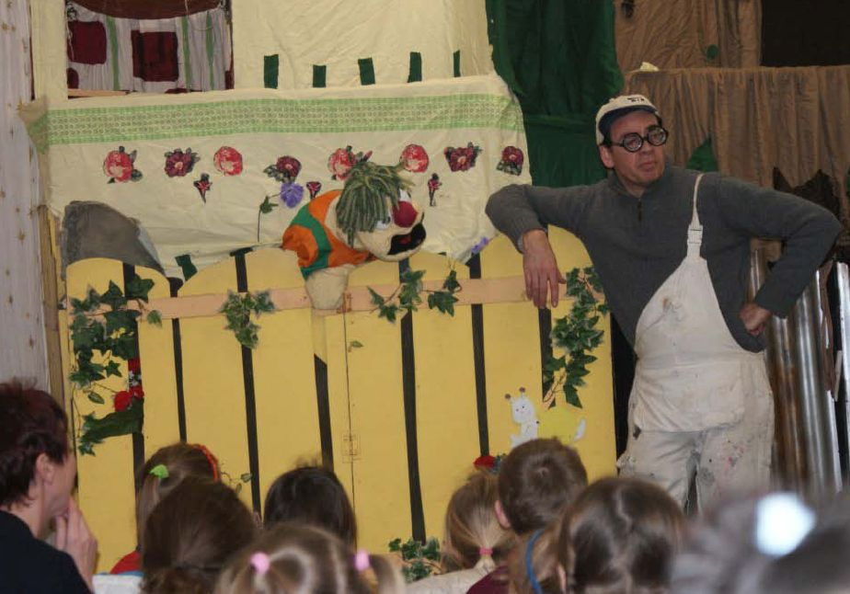
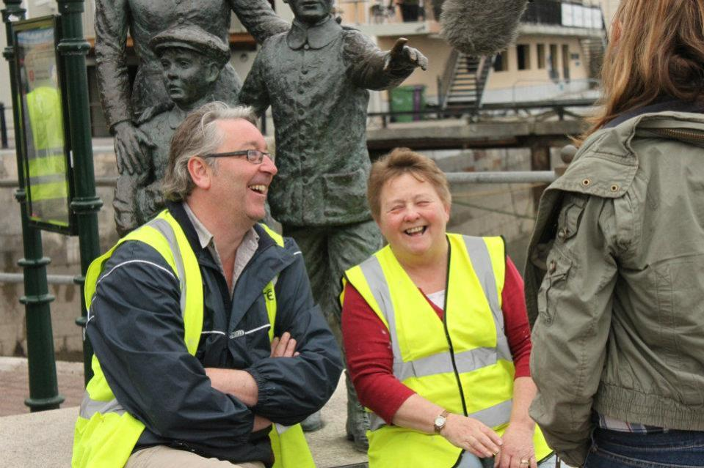
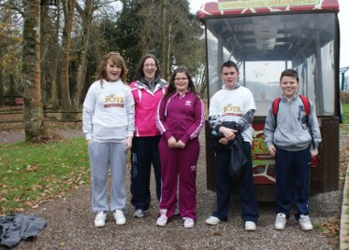

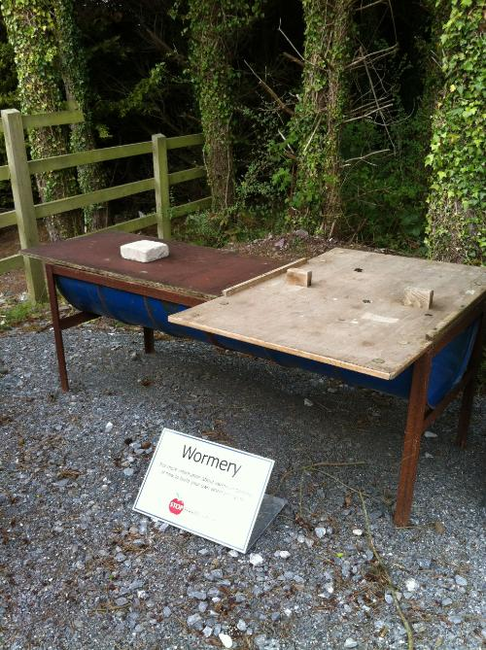
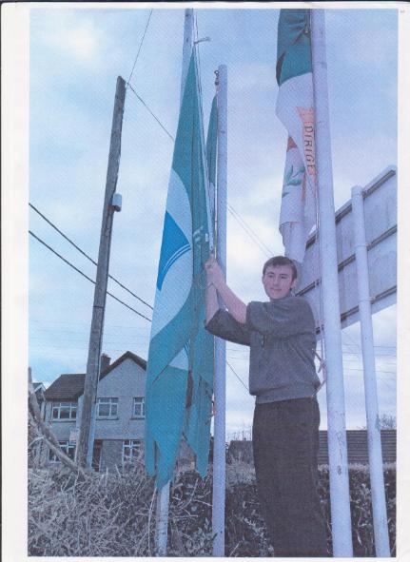

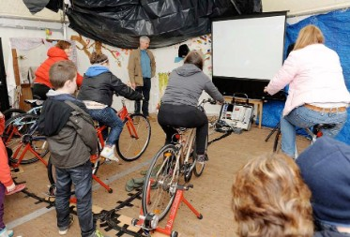
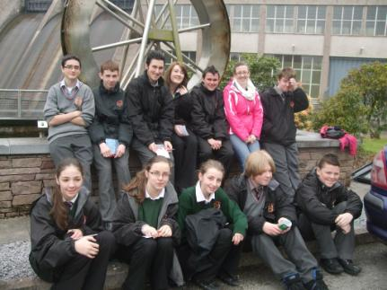
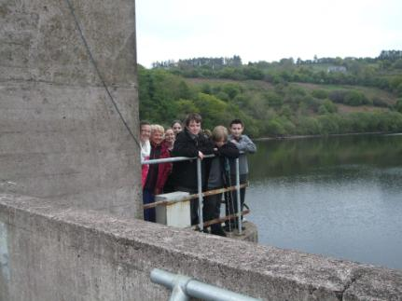
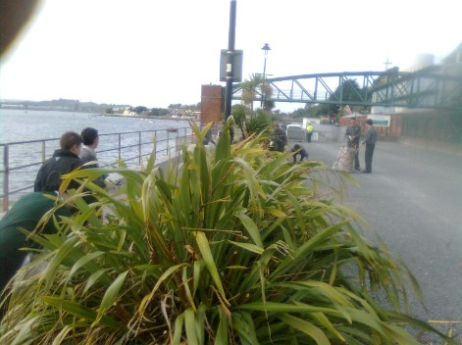
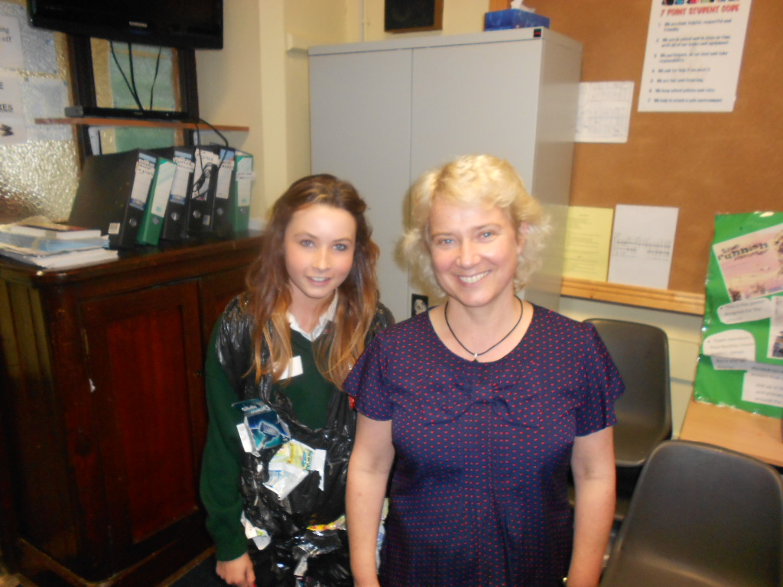
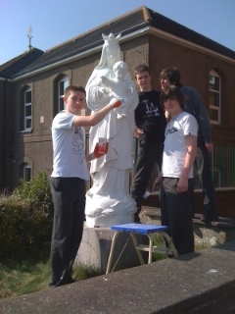
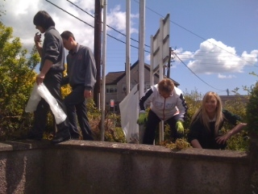
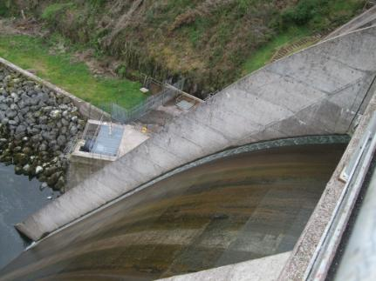
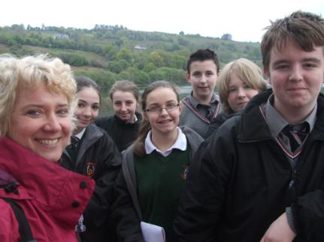

Slide 8
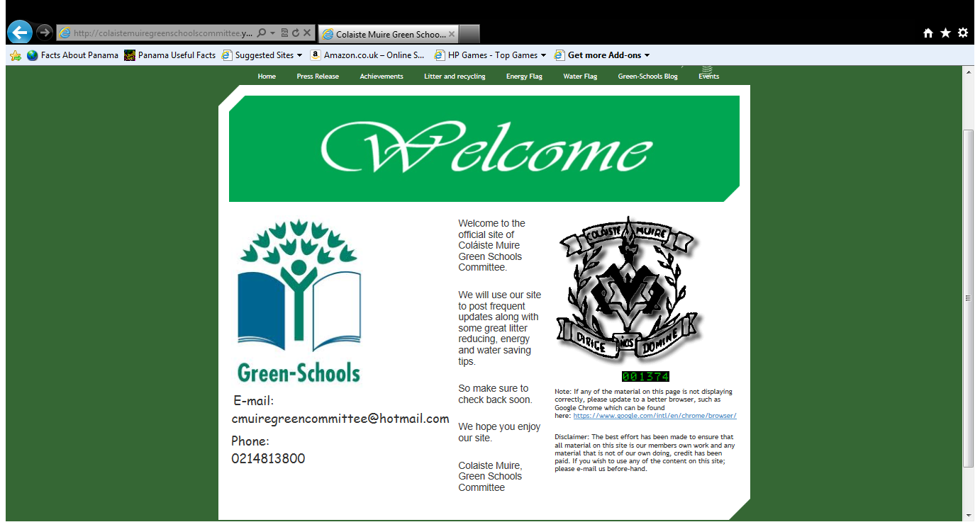
To visit our web site and to keep up to date on our work please visit our website which can be accessed by clicking on the Green Schools Committee link on the school website.

Slide 9
Thank you for your time and we hope to see you joining soon!

