Slide 1


WATER
Cork County Council supplies over 32 million gallons of clean drinking water every day

Slide 3
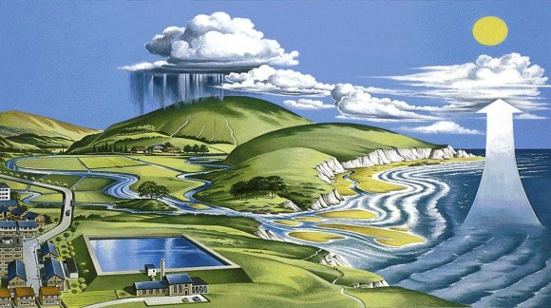
THE WATER CYCLE
3. Water vapour condenses to form clouds
4. Rain water falls to form rivers.
2
3
4
2. Water vapour is carried up into the air.
5
5. Rivers flow into the sea
1
1. Water evaporates

Slide 4
THE WATER CYCLE
A. SNOW AND ICE ON MOUNTAIN TOPS MELT AND FLOW INTO RIVERS
B. RESERVOIRS ARE MADE TO STORE WATER FOR OUR USE
A
B
C. WATER FROM RESERVOIRS IS CLEANED AT WATER WORKS AND PUMPED TO OUR HOUSES
D
D. WASTE WATER FROM OUR HOUSES IS CLEANED AT THE SEWAGE WORKS AND PUMPED BACK INTO THE SEA
C

Slide 6
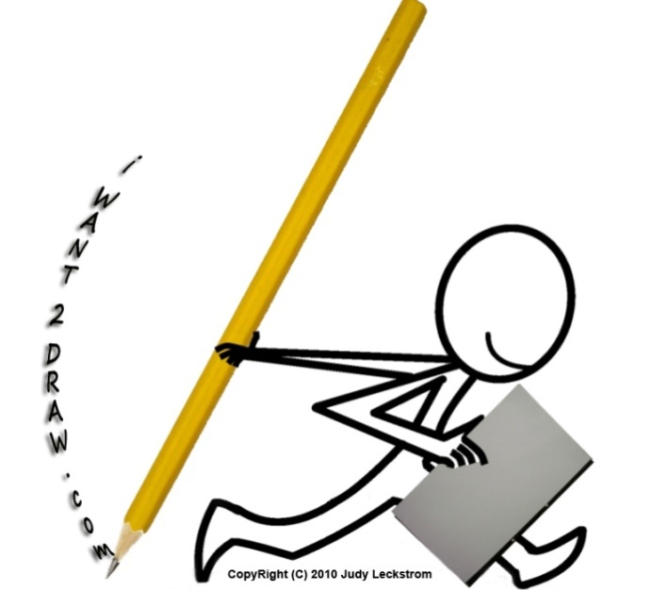
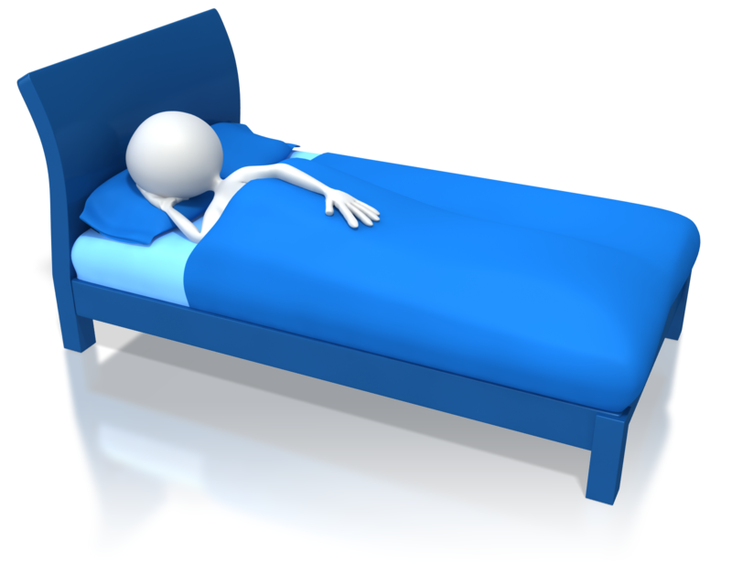

TASK
Create a water cycle diagram
Label the events 1 – 5

Slide 7


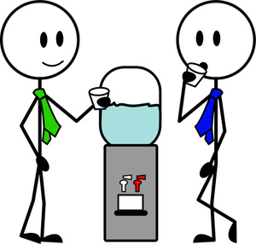
Group discussion
List 5 ways that water is used:
At play
At work
At home

Slide 8


AT PLAY

Slide 9
AT WORK

Slide 10

AT HOME

Slide 11

Fact time!
In Cork about 80% of public drinking water comes from rivers and lakes.
Less than 1% of all the water on the earth is clean enough to drink. The rest is salty or frozen.

Slide 12

Water Pollution Act
The main sources of water pollution include:
Agriculture Slurry- Cattle and Pig.
Fertillsers.
Herbicides and Pesticides.
Sewage.
Silage Effluent.
Waste Milk.

Slide 13


ENVIRONMENT
List some DANGERS to water quality
How does these polluntants affect nature?

Slide 15

Tap Tips.
Have a quick shower instead of bath.
Turn off tap when brushing your teeth.
Turn off the tap while shaving.
Use soiled dish water for watering garden pots.
Wash windows and your car with a bucket and sponge first followed by a short hosepipe rinse.

Slide 16
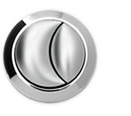
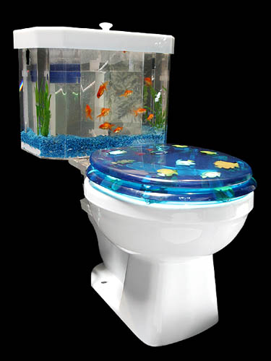
Did You Know.....
The toilets have a dual flush system. where the larger button takes six.
If you press the smaller button only 3 litres of water is used,
When you use a standard toilet you use 9 litres of water

Slide 17
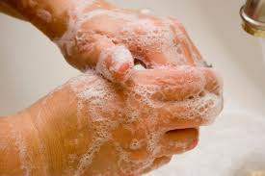
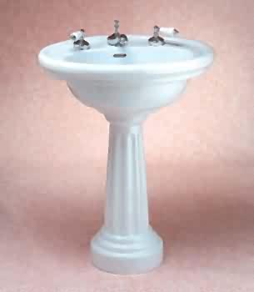
Did You Know?
When you wash your hands you use 2 litres
When you fill the sink you use 4 litres

Slide 18
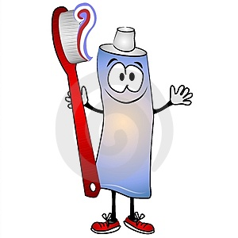
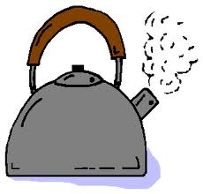
Did You Know?
When you brush your teeth you use 1 litre
When you fill the kettle you use 1 litre

Slide 19
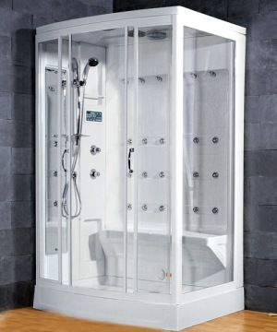
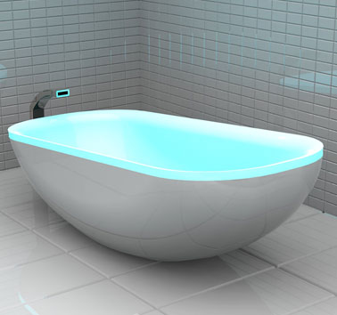
Did You Know?
80 litres
35 litres

Slide 20
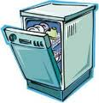
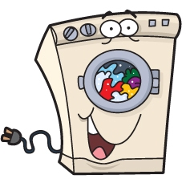
Did You Know?
Dishwasher
50 litres
Washing Machine
95 litres

Slide 21
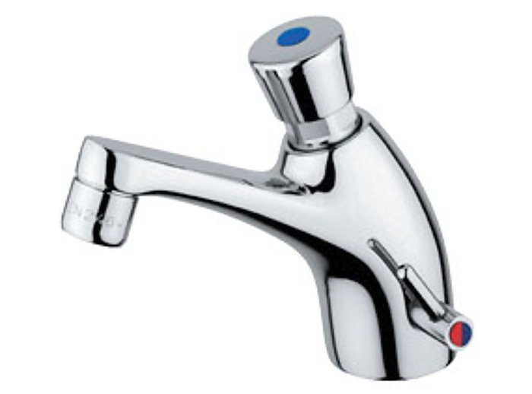
Facts for taps in school
10 seconds
43 degrees Celsius
1 gallon per minute
22
5.4 litres per minute

