Slide 1
Biodiversity
By Marie Lynch

Slide 2
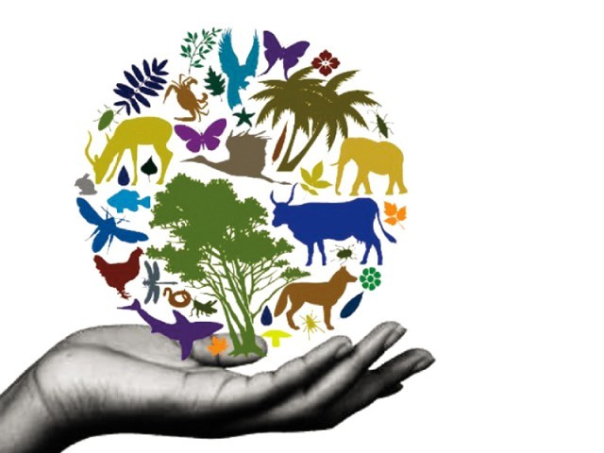
Biodiversity
Biodiversity is the variation of living organisms ecosystems and all the habitats they are apart of.
Without biodiversity the world was cease to exist.
Biodiversity is an essential natural resource which humans have taken for granted.
Biodiversity needs to be conserved as it is vital for our survival.

Slide 3
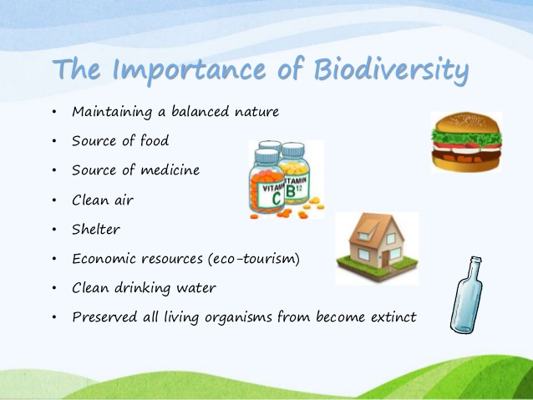
Why is Biodiversity Important?
Biodiversity is extremely important.
For example; green plants remove carbon dioxide from the atmosphere. They also release oxygen into the atmosphere.
Also different plants, animals, fungi and micro-organisms provide us with food, medicines, fuel, building materials, fibre for clothing and industrial products.

Slide 4
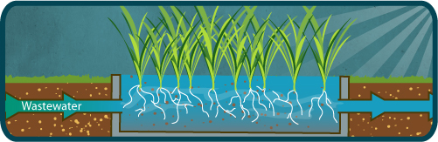
Services Provided by Ecosystems
Ecosystems reduce the risk of local and global climate change. They control the amount if gases in the atmosphere.
They protect areas from soil erosion and flooding. Vegetation protects the soil from eroding.
Also ecosystems help control pollutants. Reeds act like natural filters and remove waste from water surfaces.

Slide 5
Threats to Biodiversity
There are many different threats to biodiversity:
Habitat loss and Destruction are the major threats to biodiversity in Ireland. The destruction causes the conditions for the plants and animals to change which are vital for their survival.
Pollution also has a great impact on ecosystems. It causes death for millions of plants and animals around the world.
Climate Change has resulted due to human activity. It causes the temperature to rise by 1 or 2 degrees which causes some habitats to become uninhabitable to some species.

Slide 6
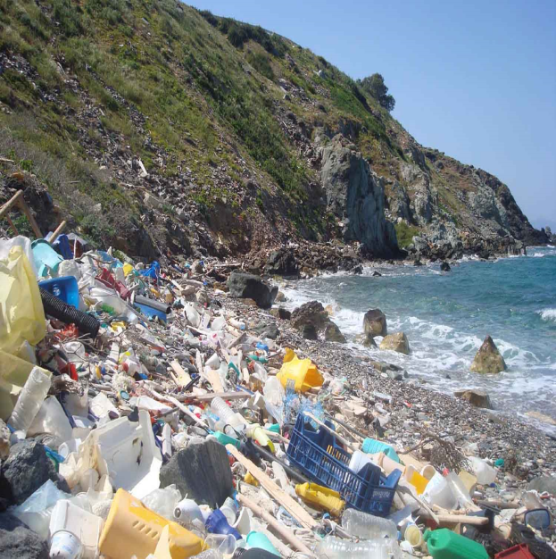
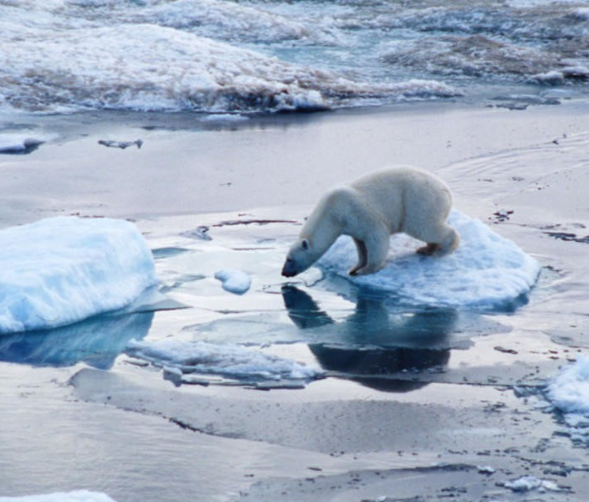
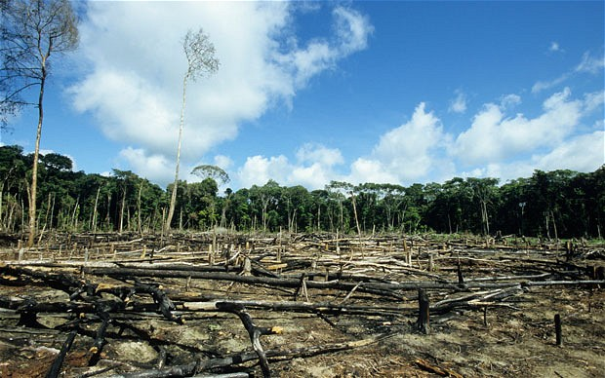
Threats to Biodiversity
Pollution
Climate change
Destruction (deforestation)

Slide 7
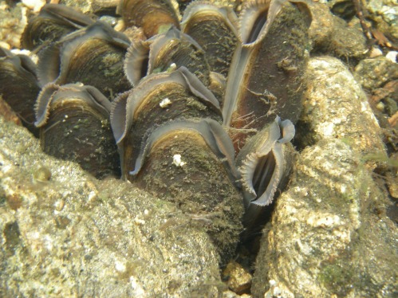
Biodiversity in Ireland
Ireland has about 815 flowering plants, about 80 native ferns, more than 700 mosses and 3,500 fungi.
There are 32 terrestrial mammals, 10 bat species, 2 species of seals and about 24 whales and dolphins in Ireland.
We have about 425 species of birds, about half of these birds breed here.
Many of these species are endangered. The freshwater pearl mussel is under serious threat and is close to extinction.
← Freshwater Pearl Mussel

Slide 8
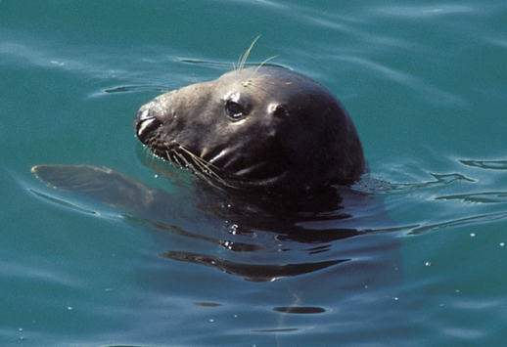
Biodiversity in Our Surrounding Seas
Ireland’s coastline is full of biodiversity and our surrounding seas.
There are many different species in our seas and we may never see some of them.
Also our sea life is being affected in negative ways, for example: pollution, overfishing and coastal activities.
We must also protect these habitats.

Slide 9
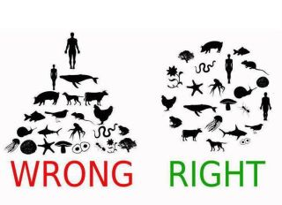
Facts about Biodiversity
It is estimated that 5 to 30 million species live on Earth but only 1.9 million species have been described.
Tropical regions contain 50-90% of Earth's plants and animals.
At the moment, 15,589 species are threatened with extinction.
Oceans cover about 70% of the entire Earth’s surface.
Less than 8% of all of the Earth’s grasslands are protected.

